Slide 1
MATRIX BARCODE BASED DETECTION AND TRACKING FOR AUTONOMOUS UAV LANDING
https://docs.google.com/presentation/d/1RnZVztZLN8G16zf2r0c12j8SaH65aVJu2ztDEzGIjlE/edit?usp=sharing
Group:
Velayudhan A : AM.EN.U4EEE17101
Nandakishore R Nair : AM.EN.U4EEE17123
Neeraj S : AM.EN.U4EEE17124
Vishnu S : AM.EN.U4EEE17147
Mentor : Mr Vivek
Asst. Professor, Electrical and Electronics,
School of Engineering, Amritapuri

Slide 2
Introduction
Dynamic remotely operated navigation equipment (DRONE) is the state of art technology that is most often associated with the military ,where they were used initially for anti-aircraft target practice intelligence gathering and then,more controversially,as weapons platform.Drones are now also used in a wide range of civilian roles ranging from search and and rescue, surveillance , traffic monitoring, weather monitoring and fire fighting , to personal drones for photography , agriculture and even delivery services.
The proposed system is composed of a Matrix barcode Code analyser mounted on board an unmanned aerial vehicle (UAV) along with on board processor, which allows the drone to be versatile enough in order to specifically to be used in object recognition,Human tracking, navigation, moving body identification, godown inspection, etc.

Slide 3
Objectives
Apriltag recognition with enhanced precision.
Localisation with respect to global frame.
Code the drone for tracking of the localised region in frame of interest.
Attain all of the above mentioned steps without third party intervention(autonomous nature).

Slide 4
Description of the system
Block diagram
HARDWARE
LANDING ZONE DETECTION
AND TRACKING SEG.
Image in frames
odometry
Velocity commands
UAV NAVIGATION
Estimated landing zone velocities and locations

Slide 5
Work done
We have been constantly updating the project prerequisites and learning the ways by which this task of autonomous uav landing using fiducial markers can be implemented. As a result we have enrolled ourselves in various courses offered by various online platforms such as edX so that the basics is strong.
Also as the trend of robotic systems is prevalent in the vast sector, proper simulation and documentation needs to be facilitated as a result the totally new concept of ROS is been focal point. We have made ways to educate ourselves with this meta operating software.
MATlab implementation of the feature extraction is been understood as it is been used in the existing packages prevalent in the UAV techs. Also the codes for the drone fight and general navigation is been exported.

Slide 6
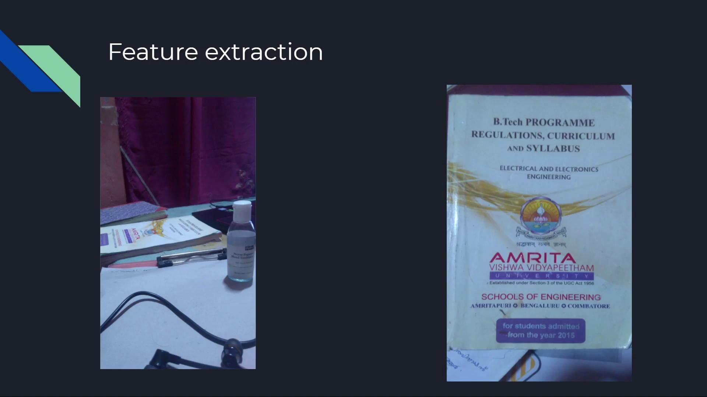
Designing

Slide 7
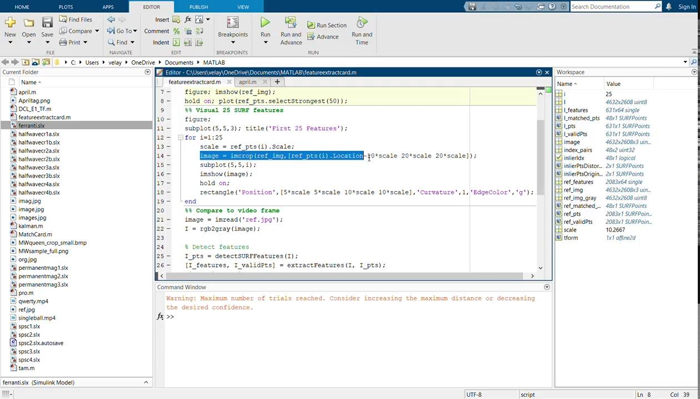

Slide 8
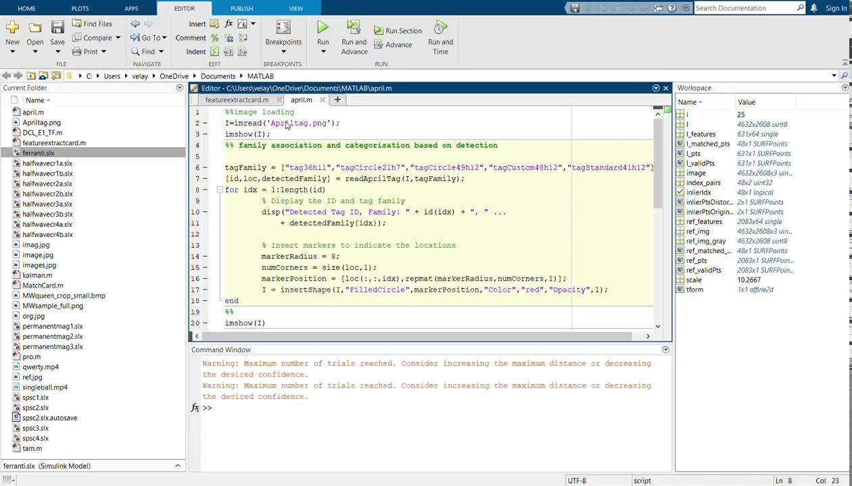

Slide 9
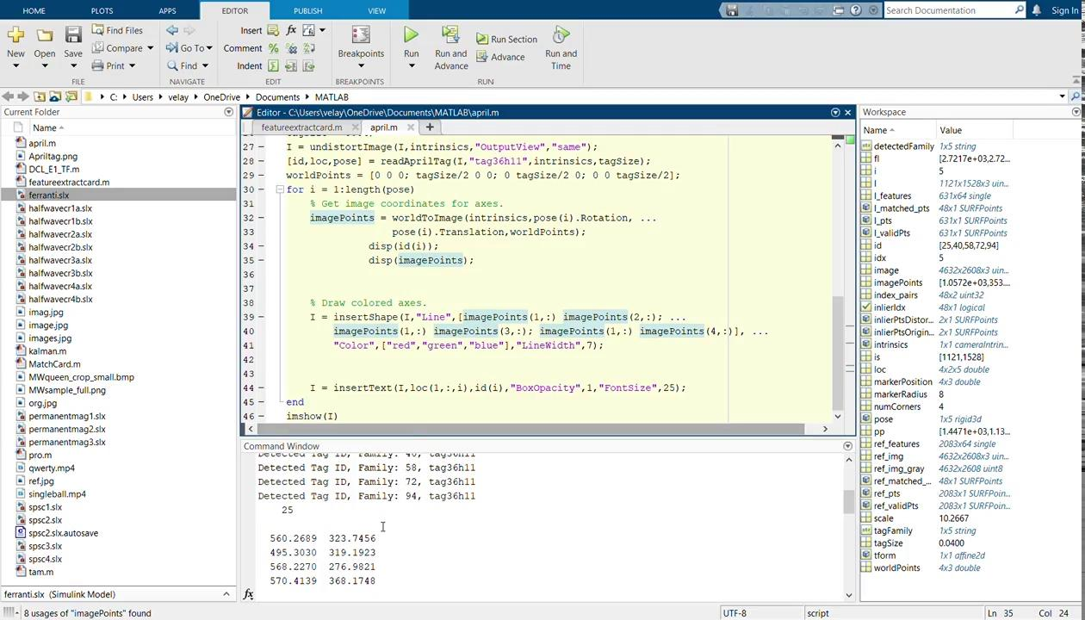

Slide 10
Diamond collection code
import quadrotor.command as cmd
from math import sqrt
def plan_mission(mission):
commands = [
cmd.up(1),
cmd.forward(1),
cmd.turn_right(90),
cmd.forward(2),
cmd.turn_left(90),
cmd.forward(4),
cmd.turn_left(90),
cmd.forward(4),
cmd.turn_left(90),
cmd.forward(4),
cmd.turn_left(135),
cmd.forward(sqrt(8))
]
mission.add_commands(commands)

Slide 11
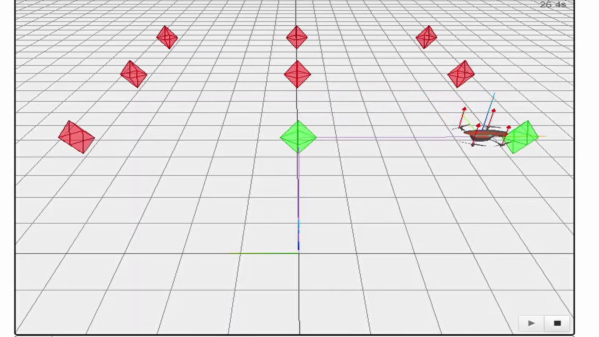
Simulation of the previous commands

Slide 12
PWM generation code
import matplotlib.pyplot as plt
###freq=50Hz timeperiod of 1 pwm=20ms max rpm at ontime=2ms min at ontime=1ms
### stable idle pwm ontime=1.25ms
##motor 1,4 in clockwise and 2,3 in anticlockwise
command=input("input the command :")
command.lower()
motor1=[]
motor2=[]
motor3=[]
motor4=[]
time=[]
for i in range(0,100):
motor1.append(0)
motor2.append(0)
motor3.append(0)
motor4.append(0)
time.append(i)
if command=="up":
print("up")
for i in range(0,100):
if i<10:
motor1[i]=1
motor2[i]=1
motor3[i]=1
motor4[i]=1

Slide 13
elif command=="down":
print("down")
for i in range(0,100):
if i<3:
motor1[i]=1
motor2[i]=1
motor3[i]=1
motor4[i]=1
else:
motor1[i]=0
motor2[i]=0
motor3[i]=0
motor4[i]=0
elif command=="left":
print("left")
for i in range(0,100):
if i<3:
motor1[i]=1
motor2[i]=1
motor3[i]=1
motor4[i]=1
elif i<10:
motor1[i]=1
motor2[i]=1
elif command=="right":
print("right")
for i in range(0,100):
if i<3:
motor1[i]=1
motor2[i]=1
motor3[i]=1
motor4[i]=1
elif i<10:

Slide 14
for i in range(0,100):
if i<3:
motor1[i]=1
motor2[i]=1
motor3[i]=1
motor4[i]=1
elif i<10:
motor1[i]=1
motor4[i]=1
print("motor1:{}".format(motor1))
print("motor2:{}".format(motor2))
print("motor3:{}".format(motor3))
print("motor4:{}".format(motor4))
plt.plot(time, motor1);
plt.axis([0,20, 0,2])
plt.plot(time, motor2);
plt.axis([0,20, 0,2])
plt.plot(time, motor3);
plt.axis([0,20, 0,2])
plt.plot(time, motor4);
plt.axis([0,20, 0,2])
motor3[i]=1
motor4[i]=1
elif command=="clockwise":
print("yaw clockwise")
for i in range(0,100):
if i<3:
motor1[i]=1
motor2[i]=1
motor3[i]=1
motor4[i]=1
elif i<10:
motor2[i]=1
motor3[i]=1
elif command=="anticlockwise":
print("yaw anti-clockwise")

Slide 15
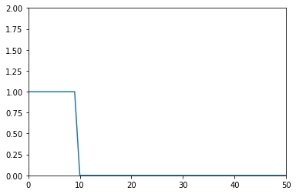
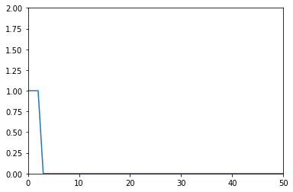
PWM Generated with code for anticlockwise yaw
Motor 1
Motor 2
Motor 3
Motor 4
Direction of rotation:
Motor 1 & Motor 4 in clockwise direction
Motor 2 & Motor 3 in anti-clockwise direction
In graph:
X-axis=time(T)
Y-axis=Voltage(V)

Slide 16
Time plan
December 2020 | Controlling the motor output with respect to the given movement commands.
January 2021 | Localisation with respect to global frame.
February 2021 | Code the drone for tracking of the localised region in frame of interest.
March 2021 | Finding the required landing pad by scanning the area.
April 2021 | Attain all of the above mentioned steps without third party intervention(autonomous nature).
May 2021 | Completing the simulation clearing all the faults in the above stages.

Slide 17
Conclusion
We intend to create a robust modular approach for tackling the autonomous UAV landing procedure by which it would be great advantages in various fields such as UAV landing in ships, UAV landing in remote charging pods for long distance coverage course and much more.

Slide 18
Reference
[1]Recognition system for QR Code on Moving Car ,
The 10th international conference on computer science and education, (ICCSE 2015) cambridge university, UK
[2]Development of a Human-Tracking Robot Using QR Code Recognition
Takashi Anezaki* ,Koki Eimon* ,Suriyon Tansuriyavong* ,Yasushi Yagi**
[3]Eye in the Sky: Drone-Based Object Tracking and 3D Localization
Haotian Zhang∗ haotiz@uw.edu University of Washington Seattle, Washington ,Gaoang Wang gaoang@uw.edu University of Washington Seattle, Washington ,Zhichao Lei zl68@uw.edu University of Washington Seattle, Washington .Jenq-Neng Hwang hwang@uw.edu University of Washington Seattle, Washington
[4]Localization and navigation using QR code for mobile robot in indoor environment
Huijuan Zhang, Chengning Zhang, Wei Yang, Chin-Yin Chen, Member, IEEE
[5]Warehouse Management Using Real-Time QR-Code and Text Detection,Debjoy Saha,IIT Kharagpur
https://www.researchgate.net/profile/Debjoy_Saha/publication/336218818_Warehouse_Management_Using_Real-Time_QR-Code_and_Text_Detection/links/5d9795ac299bf1c363f8d4d6/Warehouse-Management-Using-Real-Time-QR-Code-and-Text-Detection.pdf

